Slide 1
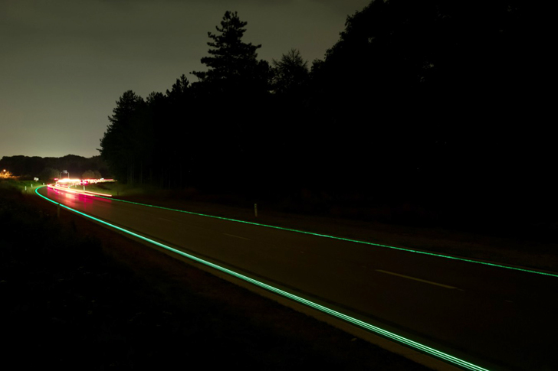
ENHANCED SMART ROADS

Slide 2
CONTENTS
INTRODUCTION
METHODOLOGY
METHODOLOGY DIAGRAM
FUTURE SCOPE
CONCLUSION

Slide 3
INTRODUCTION
Roads are the connecting paths. Road accidents are one major cause for loss of lives now days. We are here with a solution to control over speeding of vehicles technologically, to further minimize road accidents.
Design of roads with technology implementations mostly with interdependency with IOT and AI. The road construction is based on the smart road constructions which are prevailing these days with added supplements. Friction controlling is the main part here.

Slide 4
METHODOLOGY
The road is laid in layers of the following
integrations,
Speed detection and control
Horizontal stepped plates as temporary road disturbances.
Piezoelectricity production

Slide 5
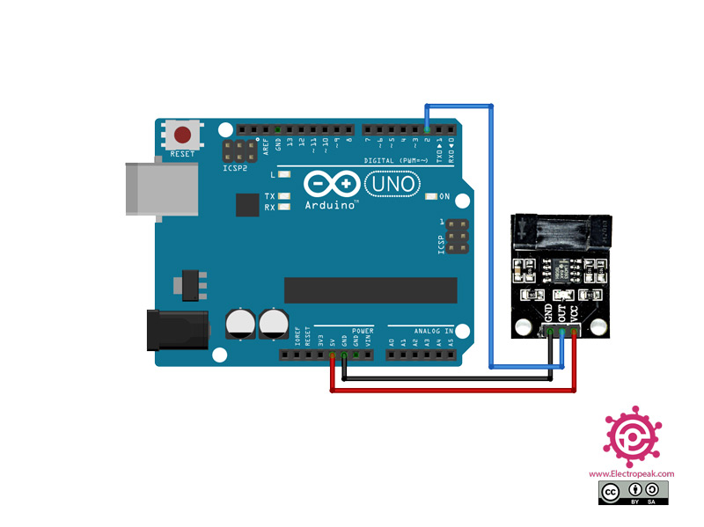
SPEED DETECTION
Speed sensors are fixed at regular intervals at the sides of the first layer. These detect the speed of the vehicle and signal the horizontal plates to fold and unfold.
INTERFACING LM393 INFRARED SPEED SENSOR WITH ARDUINO :
HARDWARE COMPONENTS
Arduino UNO R3
1LM393 Infrared Speed Sensor Module
1Male Female Jumper Wire×1
SOFTWARE COMPONENTS
Arduino IDE

Slide 6
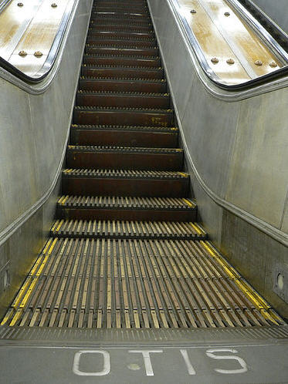
HORIZONTAL STEPPED PLATES
First layer of the road.
This act as temporary speed breakers, to control the over speeding of vehicles.
Works on the principle of escalators
These are made as a variation of the simple conveyor belt . A pair of chains wraps around two pairs of gears that are driven by an electric motor. The motor and chains sit within a metal structure known as the truss, which extends between the floors served.
Artificial intelligence is one supplementary concept here. As signal is given to these from speed sensors, this technology monitors to fold and unfold the plates, accordingly.

Slide 7
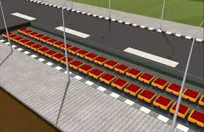
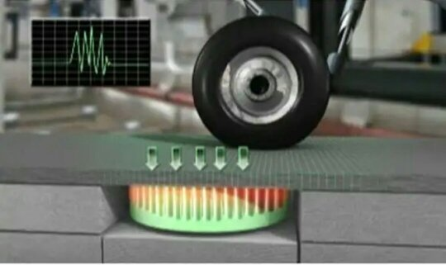
PIEZOELECTRICITY PRODUCTION
This is the second layer of the road.
Energy for the plates to fold and unfold and energy for speed sensors is created from the interior by the process of Piezoelectric Effect.
It is the ability of certain materials to generate an electric charge in response to applied mechanical stress. So here, the mechanical stress would be produced from vehicles moving on the roads. So by this, piezoelectricity will be produced.

Slide 8
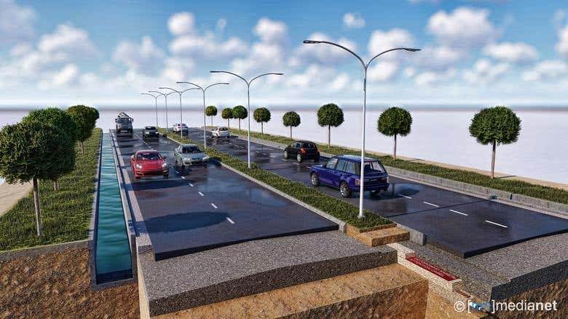
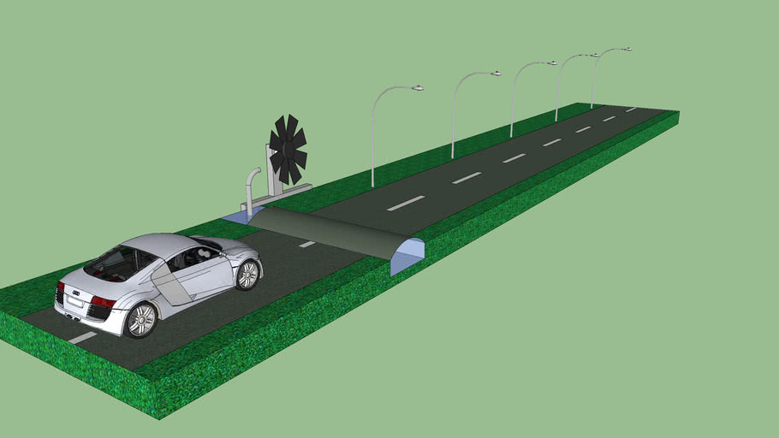
METHODOLOGY DIAGRAM

Slide 9
FUTURE SCOPE
Controls over speeding of vehicles and saves many lives from accidents.
Smart roads with most implemented technology.
Helps for the development of road transportation

Slide 10
CONCLUSION:
The road construction is based on the smart road constructions which are prevailing these days with implemented technologies. If this technique is applied in smart roads, it would decrease over speeding of vehicles and minimize accidents caused due to over speeding.
- SHRI DHARSHINI K
SHUBASHINI M

